Slide 1
Paper ID : 20 Paper Title : The Art of Deception: Adversarial Network Strategies in Thwarting Airborne Object Detection
Muhammad Saad Umer
(School of Electrical Engineering and Computer Science, National University of Sciences & Technology)
3rd International Conference on Computational Intelligent Systems
Notes:
Hello Ladies and Gentlemen, I hope you are doing well. I am Muhammad Saad Umer from the National University of Sciences and Technology, Pakistan. Today I will be spending about 10 minutes or so regarding my work which is titled The Art of Deception: Adversarial Network Strategies in Thwarting Airborne Object Detection.

Slide 2
Contents
Problem Statement /Introduction
Motivation
Contribution
Proposed Methodology – Attack Goal and Patch Generation
Results Digital Domain
Results Physical Domain
Conclusion

Slide 3
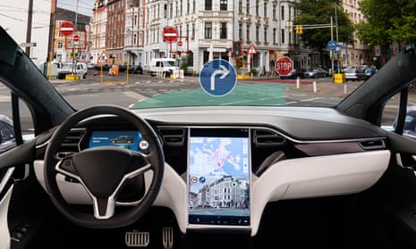

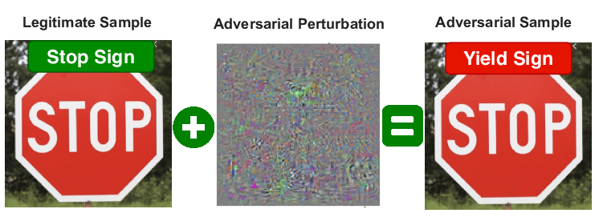
Problem Statement / Introduction
Deep Learning and Artificial Intelligence
Extensive applications in security systems
Autonomous car with object detection tasks
Surveillance system with face recognition
Door access system with voice recognition
Security issues of deep learning models
Vulnerable to adversarial attacks/perturbations
Notes:
Deep learning is at the heart of the current rise of artificial intelligence. In the field of computer vision, it has become the workhorse for applications ranging from self-driving cars to surveillance and security. Whereas, deep neural networks have demonstrated phenomenal success (often beyond human capabilities, recent studies show that they are vulnerable to adversarial attacks, in the form of subtle perturbations to inputs that lead a model to predict incorrect outputs. Just imagine what if a hacker could distort object detection model in a self-driving car and make it misclassify a stop sign as 120 km ph speed limit sign. Such attack will cause huge financial losses, physical even fatal injuries.

Slide 4
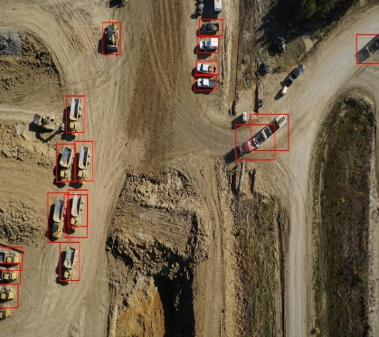
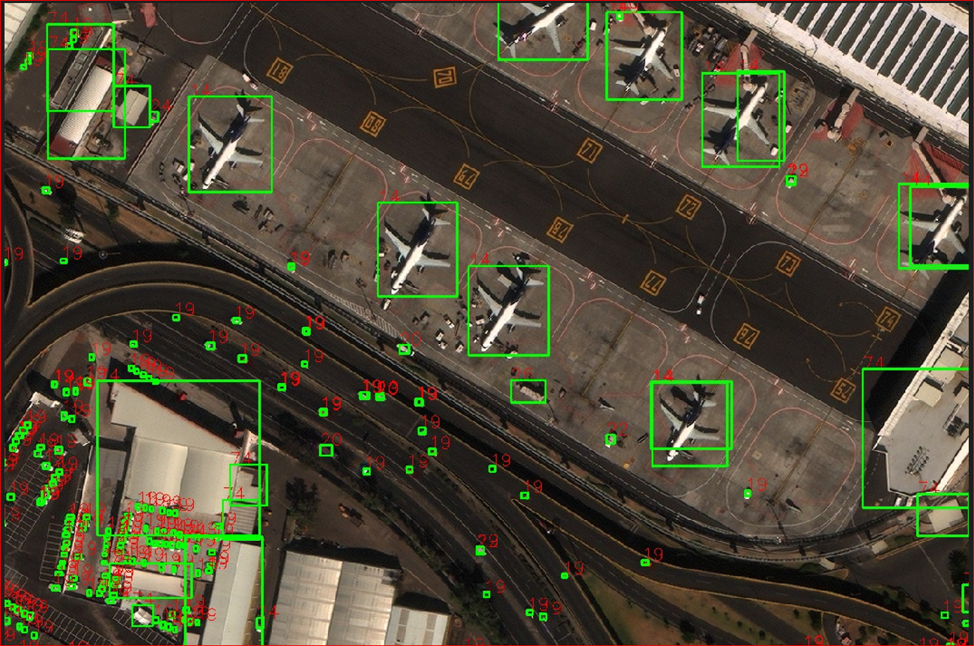
Motivation
Opportunity in real-world security-critical applications
Paradigm shift in concealing vulnerable assets
Autonomous detection systems
Drones, UAVs, Satellites
Ineffective conventional tactics
What we did?
Camouflaged aircraft from autonomous detections
Thorough adversarial patch attacks
Notes:
Although the attacks reveal weaknesses in sophisticated DNN algorithms, they might be seen as an opportunity to address issues in real-world security-critical applications. These attacks represent a paradigm change for circumstances in which vulnerable assets must be concealed from autonomous detection systems onboard drones, Unmanned Aerial Vehicles (UAVs), and satellites. Flying AI models with strong remote detection and classification capabilities may relay exact target-object kinds on the ground, compromising victim security. So we through the famework, camouflaged aircraft from autonomous detections by application of adversarial patches on the aircraft.

Slide 5
Contribution
Optimized, printed, and masked the aircraft with adversarial patches and hid them from aerial object detectors
Showed that adversarial attacks are real-world threats that can be used as an advantage
Purpose
To demonstrate adversarial attacks as real-world threats
Make way for the creation of sophisticated defense tactics
Notes:
What we did was that we optimized, printed and masked the aircraft with adversarial patches in order to hide them from object detectors. Which showed adversarial attacks are real-world threats that can be used as an advantage in ensuring safety of critical assets from autonomous detections. Furthermore, it will also open avenues for creation of more sophisticated defense tactics.

Slide 6
Proposed Methodology
Attack Goal
Optimize an adversarial patch or perturbation
Deceive object detector from detecting aircraft
Patch placement on aircraft
Target Domain: White-Box in digital and real-world scenarios
Strategy: Solving optimization problem
Notes:
I'll start by outlining the model. The goal is to create patches that stops aircraft from being detected. The patche will be placed on the aircraft body in such a way that no key features or structure of the aircraft is hidden. The attacker is expected to know all details about the aircraft detection system, such as its parameter values, architecture, loss function and optimizer etc.. They can also create and test these patches digitally before printing them for real-world use. The patches will be created through a problem-solving process, which I'll explain in more detail later.

Slide 7
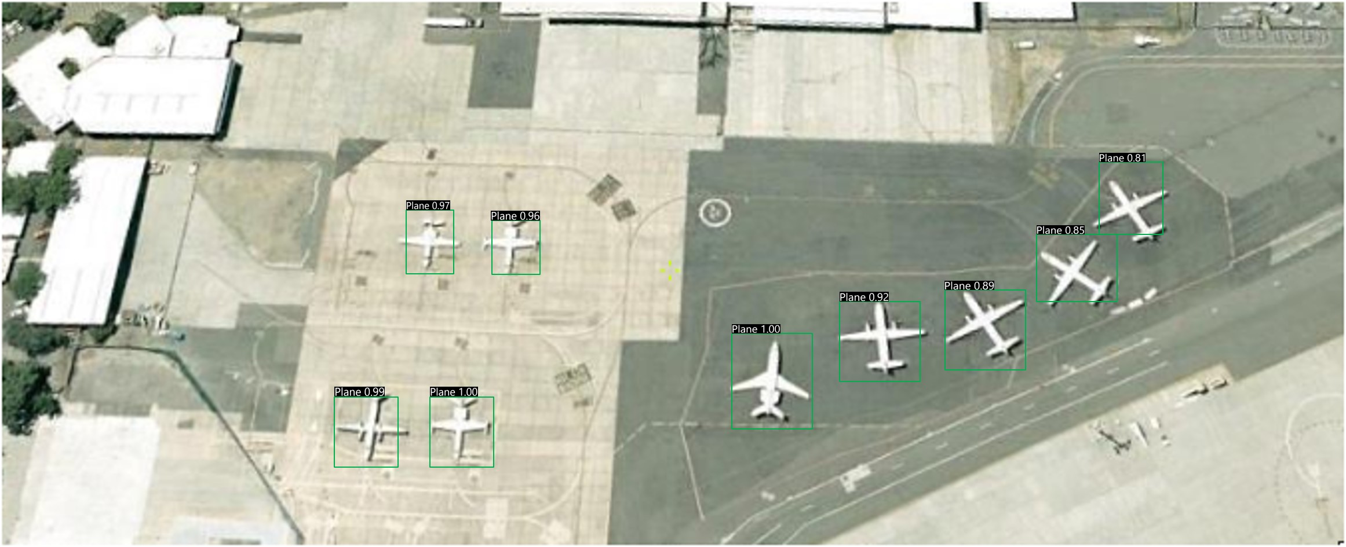
Proposed Methodology
Transfer learning on Yolov4 (Pre-trained on MS-COCO) on the DOTA Dataset.
Detector's performance is comparable to that of YOLOv4 trained on MS-COCO, with a mAP of 0.50 at an IOU threshold of 0.50.
For patch training, we used RSOD dataset; exhibiting detector efficiency
A sample from the DOTA dataset and detection by a pre-trained airborne detector on DOTA
Notes:
Before we can generate a patch and perform a physical world attack, we need a trained detector that can detect aircraft in aerial images. we did this through transfer learning a yoloV4 object detector pretrainined on MS COCO datset on DOTA dataset containing aircraft. Our detector achieved mAP of 0.50 at an IOU threshold of 0.50, which is comparable to the performance of YOLOv4 trained on MS-COCO.
For the purpose of training adversarial patches, RSOD dataset [24]. The collected images were analyzed using the HRPlanes pre-trained detector, and it was observed that the data exhibited a similar pattern, indicating the detector’s efficiency.

Slide 8
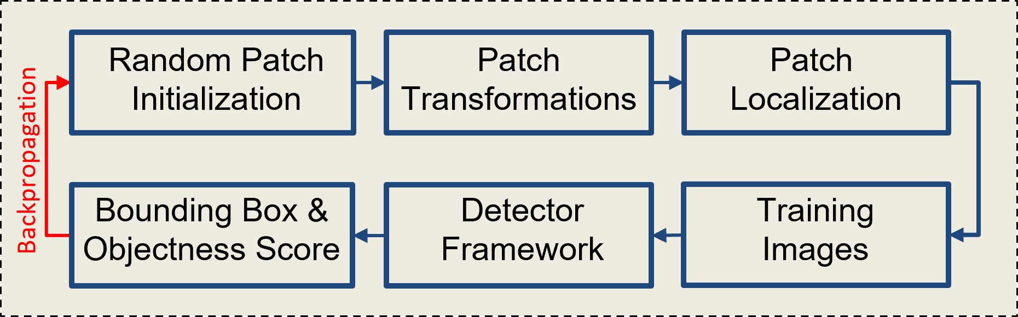
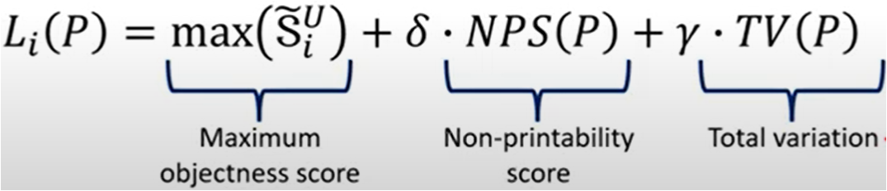
Proposed Methodology
Transfer learning on Yolov3 (Pre-trained on MS-COCO) on the HRP-planes Dataset.
Detector's performance is comparable to that of YOLOv3 trained on MS-COCO, with a mAP of 0.50 at an IOU threshold of 0.50.
For patch training, we used RSOD dataset; exhibiting detectors efficiency
Notes:
Now we are ready to create a patch. The optimization process begins with a random patch that goes into the block where patch metamorphosis and placement are done on the images of training dataset in our case which is RSOD dataset. The training image is passed through object detector which is Yolov3 and lastly the loss is calculated. The optimization objective in this study comprises three elements. (1) The metric known as the non - printability score evaluates the degree to which the hues present in our patch are capable of being precisely replicated by a conventional printing device. Where P-patch is a pixel in of our patch P and Cp is a colour in a set of printable colours . The process involves a comparison between the hues present in our patch and a predetermined range of colors that are suitable for printing purposes. The objective is to prioritize hues within the patch that exhibit a high degree of similarity to the color set that is capable of being printed. (2) The objectness score with the highest value in the image is associated with the task of detection. The aim of our study is to conceal aircraft present in the image by reducing the object or class score generated by the detector. (3) The concept of total variation loss pertains to the aggregate variance present in the image, which is indicative of the level of fluidity in the colour gradients within the patch. The optimisation process is biased towards images exhibiting gradual colour transitions and discourages those with disruptive or erratic changes. The computation of the total variation involves the comparison of adjacent pixels within the patch. We then use a simple weighted sum to calculate the total loss. These weights are trained using Adam Optimizer.

Slide 9
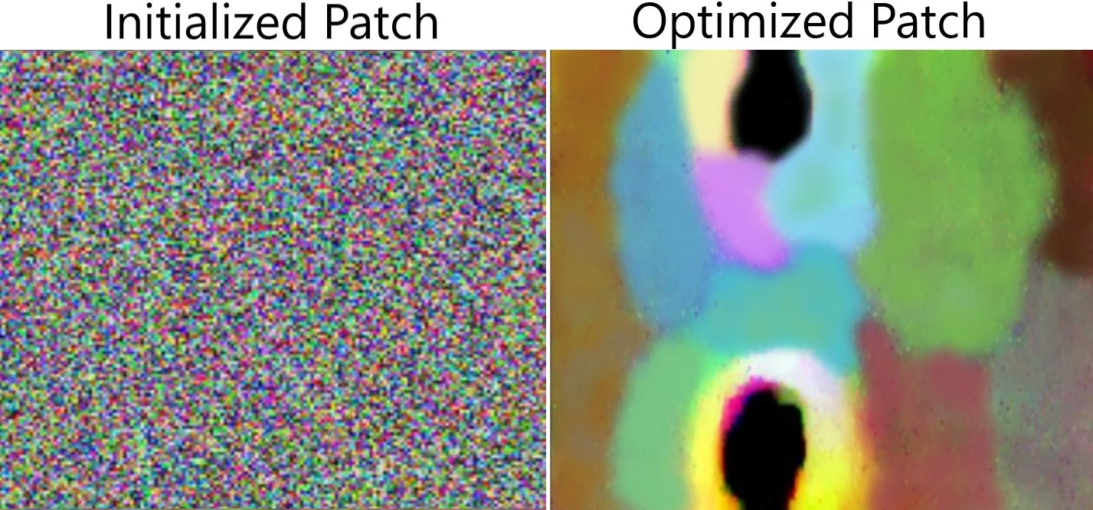
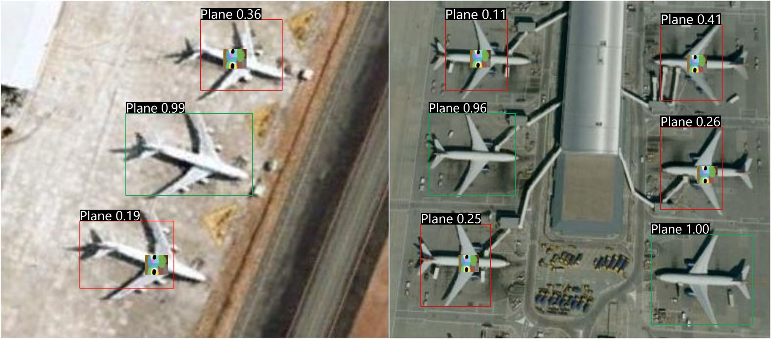
Results
The evaluation metric used in our study are Average Objectness Reduction Rate (AORR) for digital domain.
Higher AORR means attack is more effective
AORR value = 0.791 & Objectness score reduced b/w 0.23 & 0.57
Objectness score reduced considerably for aircraft with patches in the digital domain and led to the misdetection of an aircraft.
Notes:
The evaluation metric used in our study was average Objectness reduction rate for digital domain which measures the average reduction in objectness score of an object due to the adversarial patch.. A more effective attack will yield a higher AORR. We achieved AORR of 0.791 and Objectness score reduced and fluctuated between 0.23 and 0.57.

Slide 10
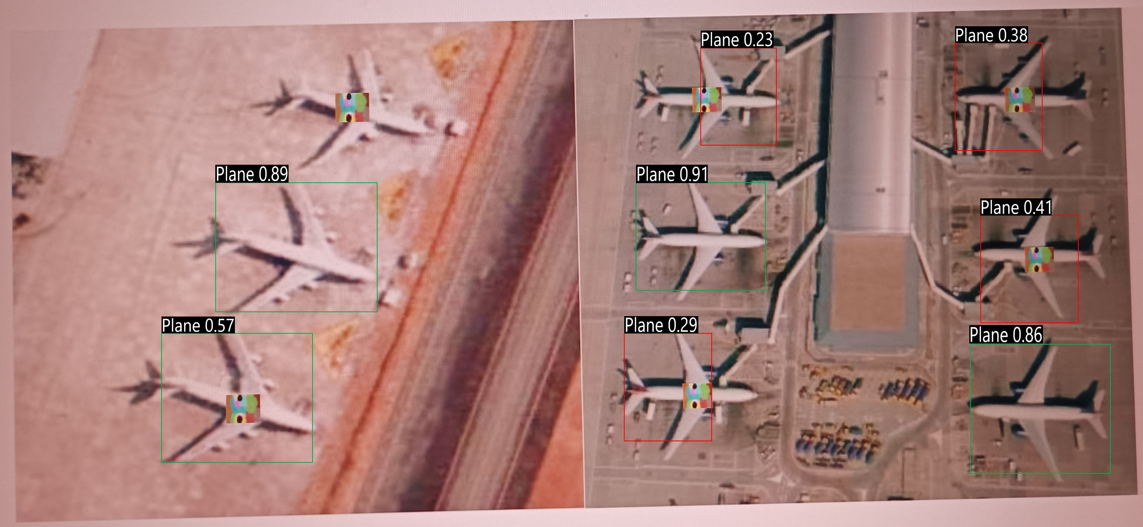
Results
The evaluation metric used in our study is Objectness Score ratio (OSR) for the physical domain.
Lower OSR means attack is more effective
OSR value = 0.319 & Objectness score reduced b/w 0.11 & 0.41
Results in the Physical domain (scaled scenario).
Notes:
The evaluation metric in physical domain was Objectness score ratio which measures the ratio of the objectness scores after and before the application of physical patch. A more effective attack will yield a lower OSR. We achieved OSR of 0. 319 and Objectness score reduced and fluctuated between 0.11 and 0.41.

Slide 11
Conclusion
Showcased the efficacy of Adversarial attacks in real-world scenarios.
Adversarial attacks are realistic threats.
Underscore the significance of taking into account and mitigating the susceptibilities linked to physical threats when developing and implementing aircraft detection technologies.
They can be used to hide vulnerable assets from autonomous surveillance.
Notes:
The study involved conducting experiments to showcase the efficacy of physical adversarial attacks on an aircraft detector in aerial scenes. This was accomplished through the development of strategically placed patches that effectively deceived the detector, resulting in inaccurate aircraft detection. The results of our experimental analysis demonstrate that physical adversarial attacks present a viable risk to the effectiveness and dependability of aircraft detection systems. The aforementioned attacks possess the capability to jeopardise the security and integrity of aerial surveillance and monitoring systems. The research outcomes also underscore the significance of taking into account and mitigating the susceptibilities linked to physical threats when developing and implementing aircraft detection technologies. These attacks can also used in our advantage by hiding vulnerable assets from autonomous detections.

Slide 12
References
References mentioned in Manuscript
Notes:
The comprehensive list of references in available in manuscript for kind review of audience.

Slide 13
Thank you
Notes:
With this I thankyou all for patient hearing. Now if you have any questions.

